Slide 1
Embedded Hardware: Hardware Building Blocks
Advanced

Slide 2
Topics to be discussed
Basic Hardware Materials:
Embedded Processors –
Introduction
ISA Architecture Models
Internal processor design
Processor Performance

Slide 3
Embedded Processors- Introduction
Processors:
main functional units
primarily responsible for processing instructions and data.
An electronic device contains at least one master processor,
There can be additional slave processors, controlled by the master processor.
Slave processors may either extend the instruction set of the master processor or act to manage memory, buses, and I/O devices.

Slide 4
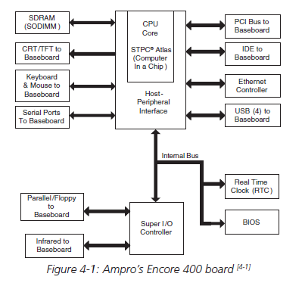
Cntd..
Below is an x86 reference board,
Here the Atlas STPC is the master processor, and the super I/O and Ethernet controllers are slave processors.

Slide 5
Cntd..
The complexity of the master processor usually determines whether it is classified as a microprocessor or a microcontroller.
Traditionally, Microprocessors contain a minimal set of integrated memory and I/O components
Microcontrollers have most of the system memory and I/O components integrated on the chip.
Though traditional definitions may not strictly apply to recent processor designs.

Slide 6
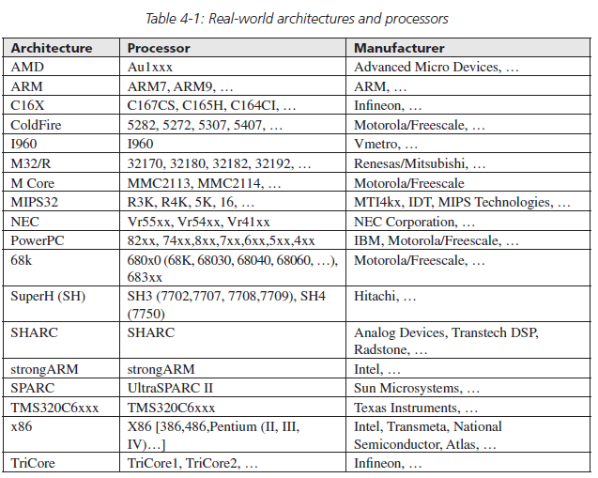
Cntd..
Embedded processors can be separated into various “groups” called architectures.

Slide 7
Embedded Processors – ISA Architecture Models
Instruction Set Architecture or ISA
The features that are built into an architecture’s instruction set.
defines such features as:
the operations,
the operands (data),
storage,
addressing modes, and
the handling of interrupts.

Slide 8
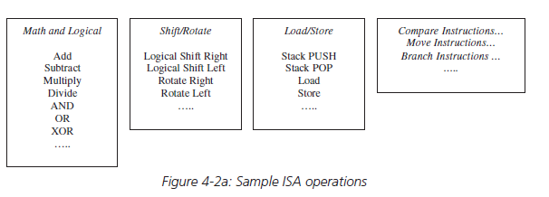
Operations
Are the functions that can be performed on the data, and they typically include computations (math operations), movement, branches, input/output operations, and context switching operations.
Example-
The instruction set on a popular lower-end processor, the 8051, includes just over 100 instructions for math, data transfer, bit variable manipulation, logical operations, branch flow and control, and so on.
A higher end MPC823 (Motorola/Freescale PowerPC) has an instruction set a little larger.

Slide 9
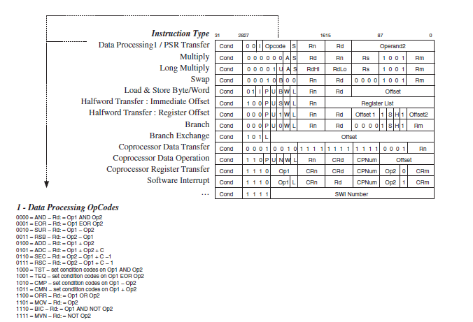
Operation Formats
An architecture, like the SA-1100(based upon the ARM v4 Instruction Set) can have several instruction set formats depending on the type of operation being performed

Slide 10
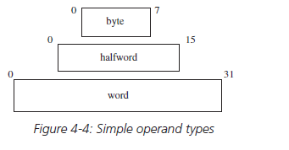
Operands
Are the data that operations manipulate.
An ISA defines the types and formats of operands for a particular architecture.
For example, for MPC823 (Motorola/Freescale PowerPC), SA-1110 (Intel StrongARM), and many other architectures, the ISA defines simple operand types of bytes (8 bits), halfwords (16 bits), and words (32 bits).

Slide 11
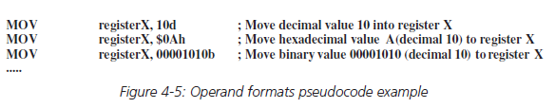
Operand formats
I means how the data looks.
ISA also defines the operand formats that a particular architecture can support, such as binary, decimal and hexadecimal.

Slide 12
Storage
The ISA specifies the features of the programmable storage used to store the data being operated on,
The organization of memory
For example:
68000 and SPARC are big-endian
x86 is little-endian
ARM, MIPS and PowerPC can be configured as either big-endian or little-endian
Register Set
How Registers Are Used
Addressing Modes
Interrupts and Exception Handling

Slide 13
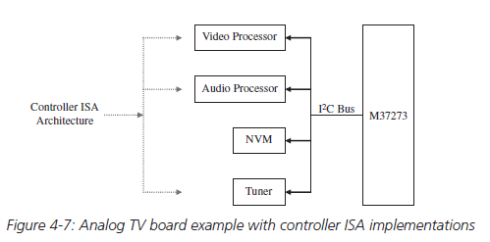
Application-Specific ISA Models
Controller Model-
Implemented in processors that are not required to perform complex data manipulation,
Example-video and audio processors (used as slave processors on a TV board)

Slide 14
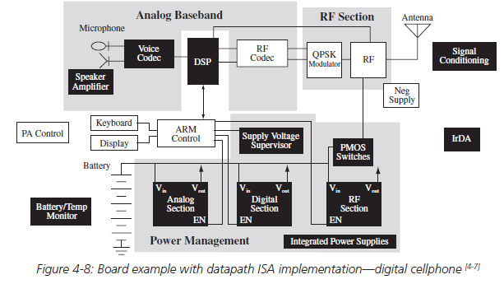
Cntd..
Datapath Model
The Datapath ISA is implemented in processors whose purpose is to repeatedly perform fixed computations on different sets of data,
a common example being digital signal processors (DSPs)

Slide 16
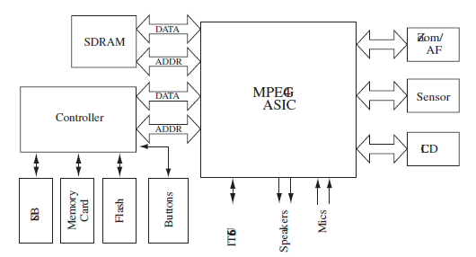
Cntd..
Finite State Machine with Datapath (FSMD) Model
Combination of the Datapath ISA and the Controller ISA
Used for processors that are not required to perform complex data manipulation and must repeatedly perform fixed computations on different sets of data.
Examples - application-specific integrated circuits (ASICs), programmable logic devices (PLDs), and field-programmable gate-arrays (FPGAs).

Slide 17
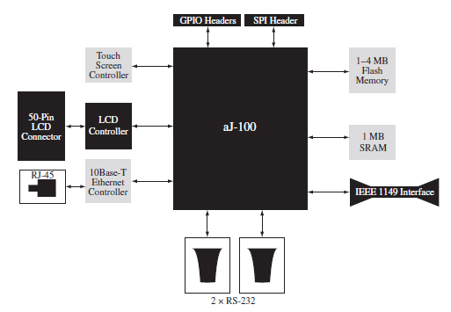
Cntd..
Java Virtual Machine (JVM) Model
The JVM ISA is based upon one of the Java Virtual Machine standards (Sun Microsystem’s Java Language).
Real-world JVMs can be implemented in an embedded system via hardware, such as in aJile’s aj-80 and aj-100 processors,

Slide 18
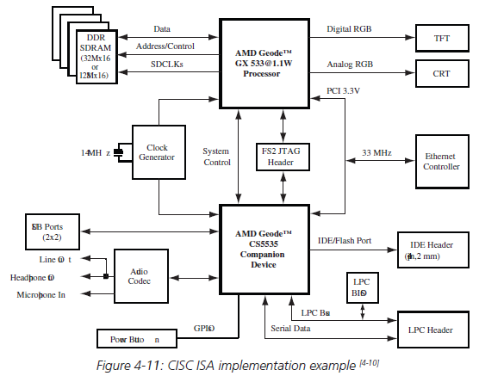
General-Purpose ISA models
Complex Instruction Set Computing (CISC) Model
Defines complex operations made up of several instructions.
CISCs typically have multiple cycle operations.
Examples of architectures that implement a CISC ISA –
Intel’s x86 and Motorola/Freescale’s 68000 families of processors.

Slide 19
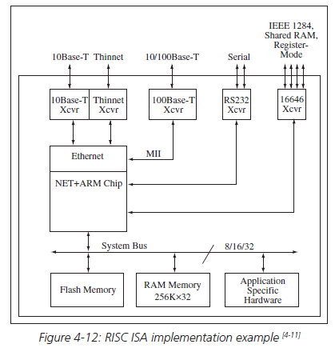
Cntd..
Reduced Instruction Set Computing (RISC) Model
In contrast to CISC, the RISC ISA usually defines:
an architecture with simpler and/or fewer operations made up of fewer instructions.
architecture that has a reduced number of cycles per available operation.
Many RISC processors have only one-cycle operations, Examples- ARM, PowerPC, SPARC, and MIPS

Slide 20
Instruction-Level Parallelism ISA Models
These ISA architectures execute multiple instructions in parallel, as the name implies.
Are considered higher evolutions of the RISC ISA.
Example-
Single Instruction Multiple Data (SIMD) Model,
Superscalar Machine Model,
Very Long Instruction Word Computing (VLIW) Model

Slide 21
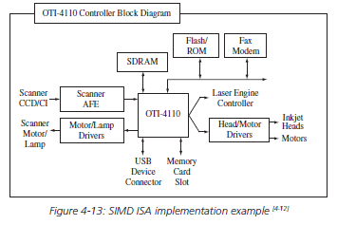
Cntd..
Single Instruction Multiple Data (SIMD) Model
Designed to process an instruction simultaneously on multiple data components that require action to be performed on them.

Slide 22
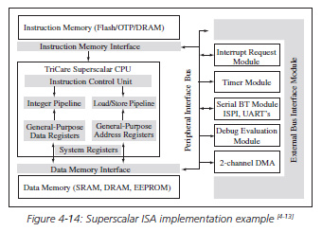
Cntd..
Superscalar Machine Model
Able to process multiple instructions simultaneously within one clock cycle through the implementation of multiple functional components within the processor.

Slide 23
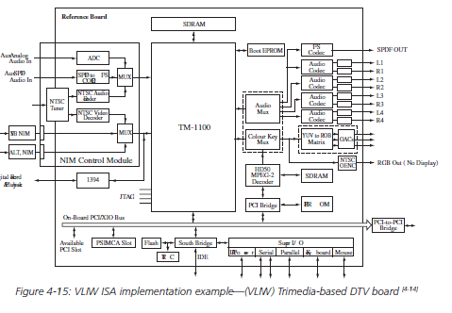
Cntd..
Very Long Instruction Word Computing (VLIW) Model
The VLIW ISA defines an architecture in which a very long instruction word is made up of multiple operations.
These operations are then broken down and processed in parallel by multiple execution units within the processor.

Slide 24
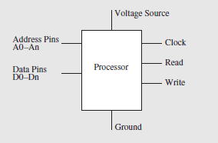
Internal Processor Design
Processors typically have address and data signals to read and write data to and from memory.
In order to communicate to memory or I/O, a processor usually has some type of READ and WRITE pins to indicate it wants to retrieve or transmit data.

Slide 25
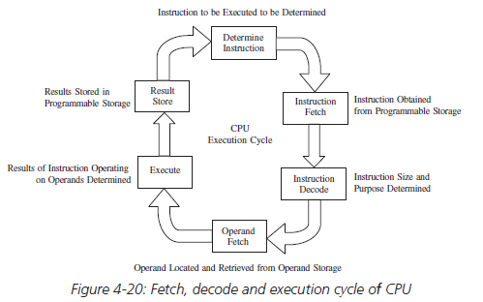
CPU
It is the processing unit within a processor.
The CPU is responsible for executing the cycle of fetching, decoding, and executing instructions.
This three-step process is commonly referred to as a three-stage pipeline.

Slide 26
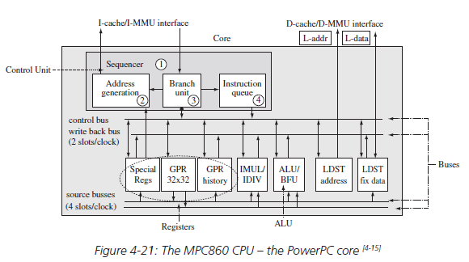
CPU components:
Four major CPU components:
Arithmetic Logic Unit (ALU) – implements the ISA’s operations
Registers – a type of fast memory
Control Unit (CU) – manages the entire fetching and execution cycle
Internal CPU Buses – interconnect the ALU, registers, and the CU

Slide 27
Processor Performance
There are several measures all of which are based upon the processor’s behavior over a given length of time.
One of the most common definitions of processor performance is a processor’s throughput
Amount of work the CPU completes in a given period of time.
Another popular definition is CPU’s execution time.
total time the processor takes to process some program in seconds per program

Slide 28
Cntd..
processor’s execution is synchronized by an external system or master clock, located on the board.
The master clock is simply an oscillator producing a fixed frequency sequence of regular on/off pulse signals
is usually divided or multiplied within the CPU’s CU (control unit) to generate at least one internal clock signal running at a constant number of clock cycles per second, or clock rate,
to control and coordinate the fetching, decoding, and execution of instructions.
The CPU’s clock rate is expressed in MHz (megahertz).

Slide 29
Cntd..
Benchmarks
One of the most common performance measures used for processors in the embedded market is millions of instructions per seconds or MIPS.
MIPS = Instruction Count / (CPU execution time * 106) = Clock Rate / (CPI * 106)
Faster processors have higher MIPS values
However, MIPS can be misleading for a number of reasons, including:
Instruction complexity and functionality aren’t taken into consideration in the MIPS formula, so MIPS cannot compare the capabilities of processors with different ISAs.
MIPS can vary on the same processor when running different programs (with varying instruction count and different types of instructions).

Slide 30
Thank You

